Slide 1
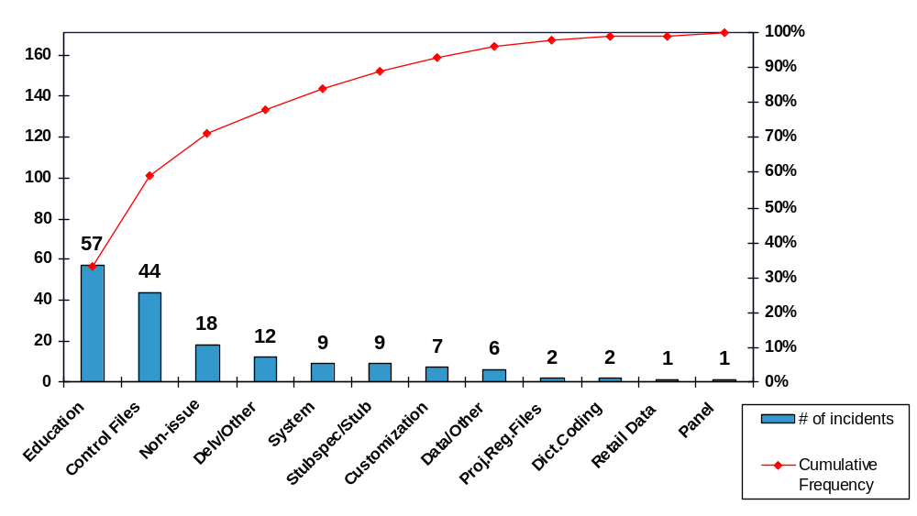
Cause Types YTD 2002 – Retail Delivery
We used this pareto chart to determine what type of incidents are resolved by the RCG team. By looking at this chart it became very clear that RCG spends a lot of time in dealing with issues that end up being Education Issues.
This chart allowed us to determine where our focus should be. As a result, we drilled down on the Education incidents and found out that more than 50% of them were actually one question that kept coming back. We are now brainstorming on how this FAQ can be better communicated.
Incident Tracking database
Copyright © Information Resources, Inc. 2002. Confidential and proprietary.
Notes:
We used this pareto chart to determine what type of incidents are resolved by the RCG team. By looking at this chart it became very clear that RCG spends a lot of time in dealing with issues that end up being Education Issues.
This chart allowed us to determine where our focus should be. As a result, we drilled down on the Education incidents and found out that more than 50% of them were actually one question that kept coming back. We are now brainstorming on how this FAQ can be better communicated.

Slide 2
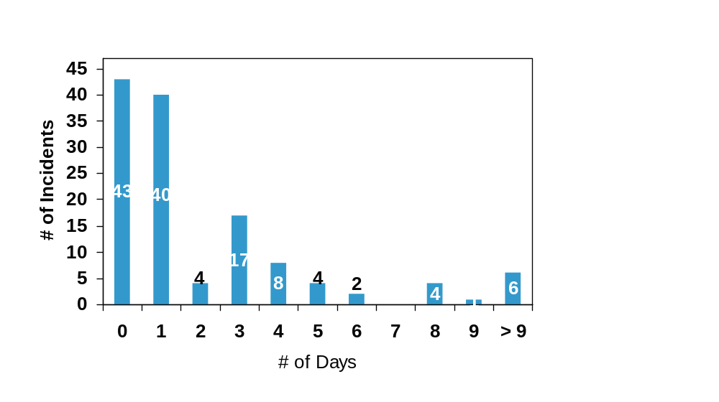
8-Day Resolution Timing To Date
Target SLA: 95%
8 Day
In SLA:95%
Out SLA: 5%
This frequency chart is a great tool to measure SLAs. This chart represents how many days it takes the Data Investigation team to resolve incidents that were assigned an “8-Day” timing quote.
By the beginning of next year, we will be able to go back to this chart and evaluate if the SLA should be revised.
We will also be able to go back to our data and figure out how the bulk of our issues can be resolved between day 0 and day 3. It also makes it easier to identify those which didn’t make the SLA, to go back and see what happened.
Data Investigation database
Measurement starts on 6/1/02
Copyright © Information Resources, Inc. 2002. Confidential and proprietary.
Notes:
This frequency chart is a great tool to measure SLAs. This chart represents how many days it takes the Data Investigation team to resolve incidents that were assigned an “8-Day” timing quote.
By the beginning of next year, we will be able to go back to this chart and evaluate if the SLA should be revised.
We will also be able to go back to our data and figure out how the bulk of our issues can be resolved between day 0 and day 3. It also makes it easier to identify those which didn’t make the SLA, to go back and see what happened.

